Slide 1
Seminar 4: Security Standards
Team B
Sathira Padukka, Babatunde Ahmed, Yin Ping Lai
https://www.allmytype.co.uk

Slide 2
Overview
PCI and the General Data Protection Regulation (GDPR) are designed to enhance end-user safety and secure personal data. While GDPR encompasses any and all personal identifying data collected from anyone in the EU. From opt-in information collected as part of a marketing initiative to information about specific orders and behaviors, the GDPR exists to ensure that personal data is not exploited, is deleted upon demand, and is only used as long as the individual consents. PCI DSS covers the handling of credit cards and personal data. The two however overlap in the protection of user Payment Card Data.

Slide 3
Evaluation of Security Standards
https://www.allmytype.co.uk is a blog-type application that allows users to log in and enter their blog and allow other users to read their thoughts on the subject with the primary target being the audience from the United Kingdom. The site holds basic user information and maintains user accounts and profile information, login activities, post, and responses.
The basic data retrieved by the application makes it fall under the GDPR which covers all basic information received by all application under the range of the European Union. Since the website does not have any card payment implementation , the website does not have the PCI standards applicable to its operations.
For our application we will have to use ICO (2020) Guide to the General Data Protection Regulation (GDPR) standard since All My Type application handles users' information (login credentials, user information such as name, email, and etc.)

Slide 4
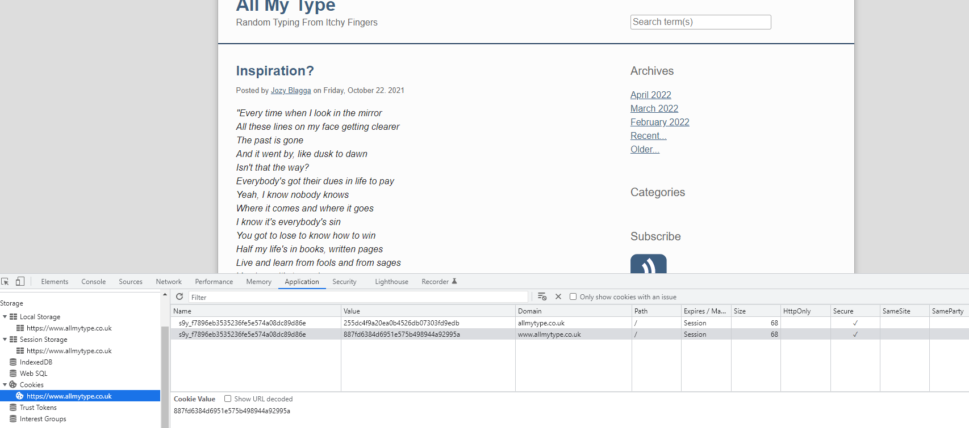
Evaluation (Cont.)
The assigned website does not meet the GDPR standards as it does not seek explicit consent from users to track their online behavior via cookies. To achieve this standard, the website should include a pop-up on the user's first visit to accept or decline consent on cookie usage.

Slide 5
Evaluation (Cont.)
The privacy policy is also missing in the assigned website as it does not provide a conspicuous notice to inform users that it collecting their personal data. As a result, the website should provide a visible conspicuous privacy policy to users.
There is no option to opt out or delete account and profile information which should be made available based on the guideline of GDPR.

Slide 6
Recommendation
We would provide the following recommendations and adjustments on https://www.allmytype.co.uk be made to meet the GDPR standards?
Include a pop-up on the user's first visit to accept or decline consent on cookie usage allowing the website to track the user's behavior while they are in the application.
Create the concrete privacy policy page and inform users while collecting their personal data from the application.
Provide an option for user to remove information and related activities on the site.

Slide 7
Assumptions
The following assumptions are made in the evaluation of https://www.allmytype.co.uk/.
There is no payment or checkout page/implementation that might require card information input on the site.

